Slide 1
Chapter 7
Multiple Regression Analysis with Qualitative Information

Slide 2
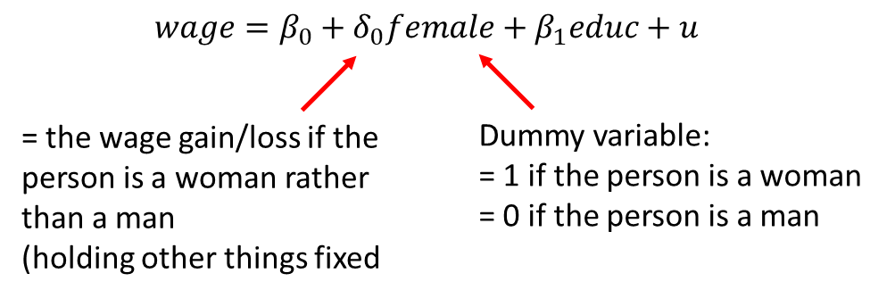
Multiple Regression Analysis with Qualitative Information (1 of 24)
Qualitative Information
Examples: gender, race, industry, region, rating grade...
A way to incorporate qualitative information is to use dummy variables.
They may appear as the dependent or as independent variables.
A single dummy independent variable

Slide 3
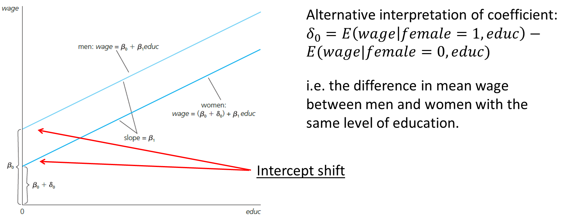
Multiple Regression Analysis with Qualitative Information (2 of 24)
Graphical Illustration

Slide 4
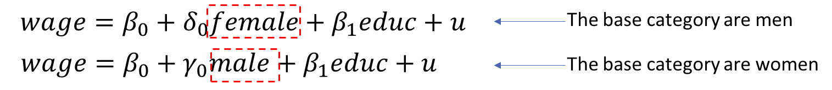
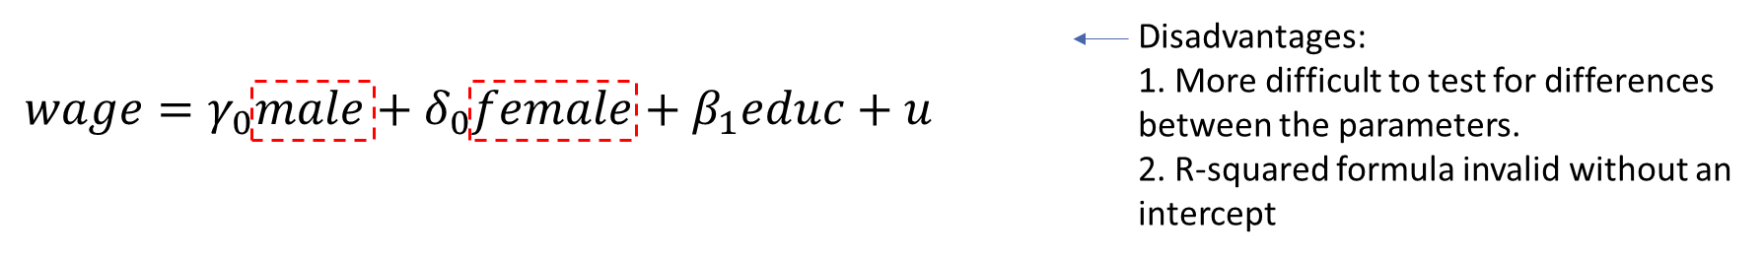
Multiple Regression Analysis with Qualitative Information (3 of 24)
Dummy variable trap
When using dummy variables, one category always has to be omitted:
Alternatively, one could omit the intercept

Slide 5
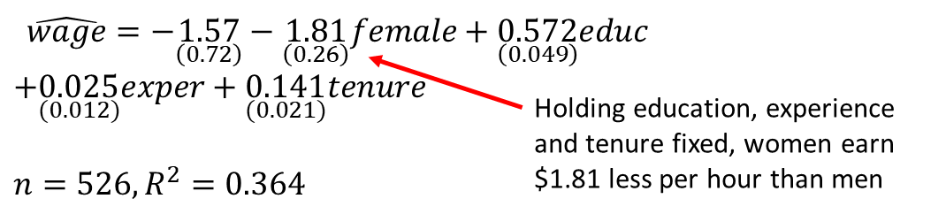
Multiple Regression Analysis with Qualitative Information (4 of 24)
Estimated wage equation with intercept shift
Does that mean that women are discriminated against?
Not necessarily. Being female may be correlated with other produc-tivity characteristics that have not been controlled for.

Slide 6
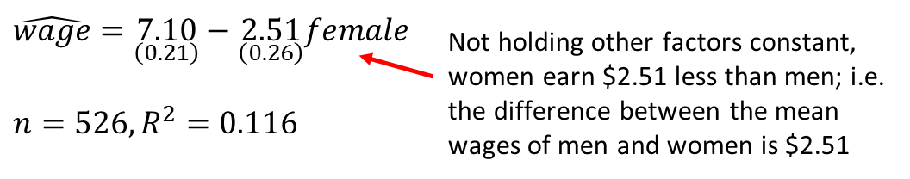
Multiple Regression Analysis with Qualitative Information (5 of 24)
Comparing means of subpopulations described by dummies
Discussion
It can easily be tested whether the difference in means is significant.
The wage difference between men and women is larger if no other things are controlled for; i.e. part of the difference is due to differences in education, experience, and tenure between men and women.

Slide 7
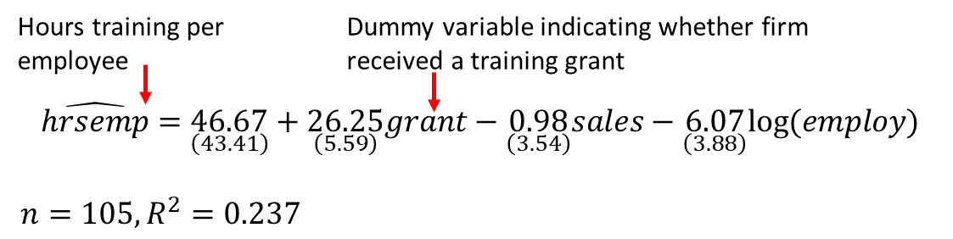
Multiple Regression Analysis with Qualitative Information (6 of 24)
Further example: Effects of training grants on hours of training
This is an example of program evaluation
Treatment group (= grant receivers) vs. control group (= no grant)
Is the effect of treatment on the outcome of interest causal?

Slide 8
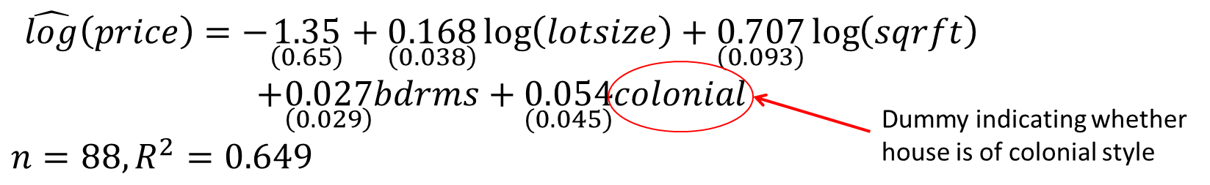
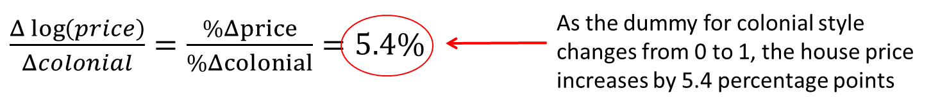
Multiple Regression Analysis with Qualitative Information (7 of 24)
Using dummy explanatory variables in equations for log(y)

Slide 9
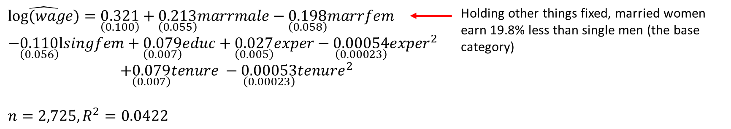
Multiple Regression Analysis with Qualitative Information (8 of 24)
Using dummy variables for multiple categories
1) Define membership in each category by a dummy variable
2) Leave out one category (which becomes the base category)

Slide 10
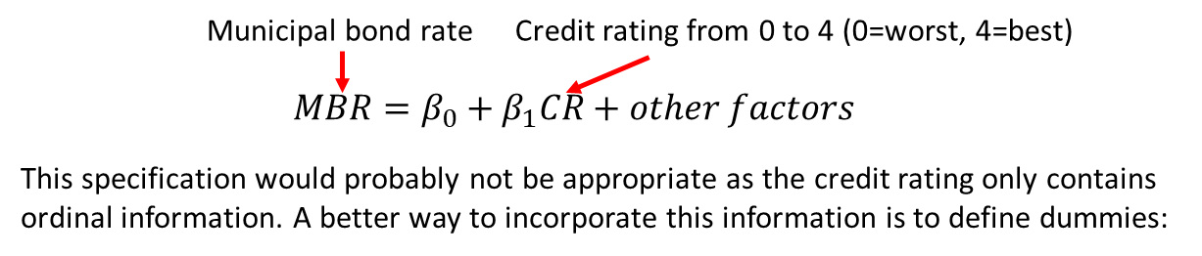
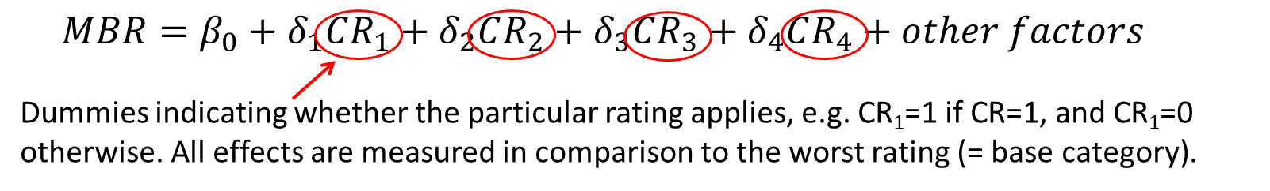
Multiple Regression Analysis with Qualitative Information (9 of 24)
Incorporating ordinal information using dummy variables
Example: City credit ratings and municipal bond interest rates

Slide 11
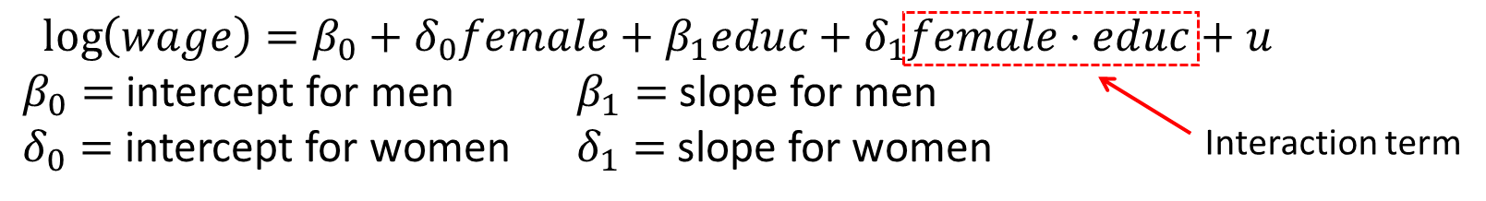
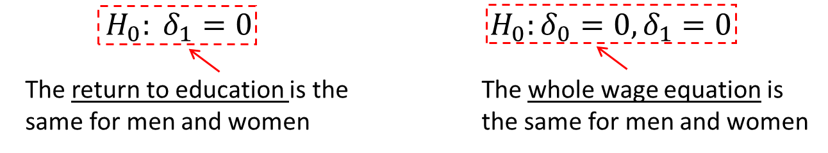
Multiple Regression Analysis with Qualitative Information (10 of 24)
Interactions involving dummy variables
Allowing for different slopes
Interesting hypothesis

Slide 12
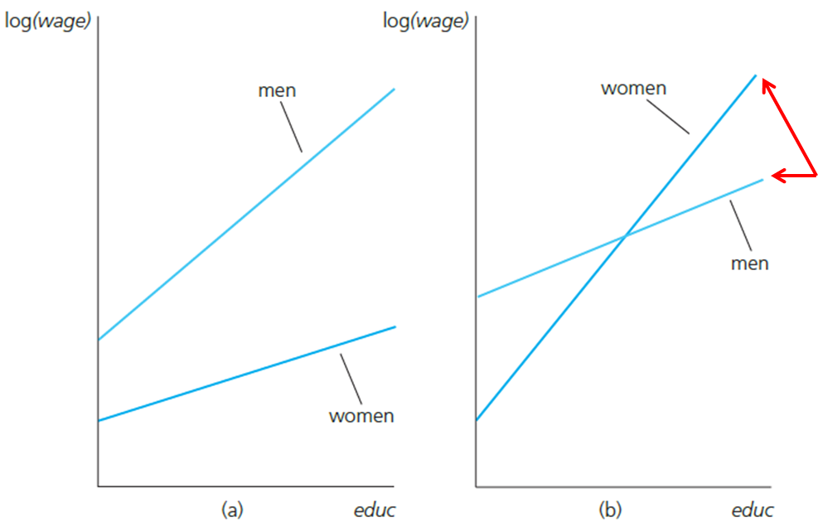
Multiple Regression Analysis with Qualitative Information (11 of 24)
Graphical illustration
Interacting both the intercept and the slope with the female dummy enables one to model completely independent wage equations for men and women.

Slide 13
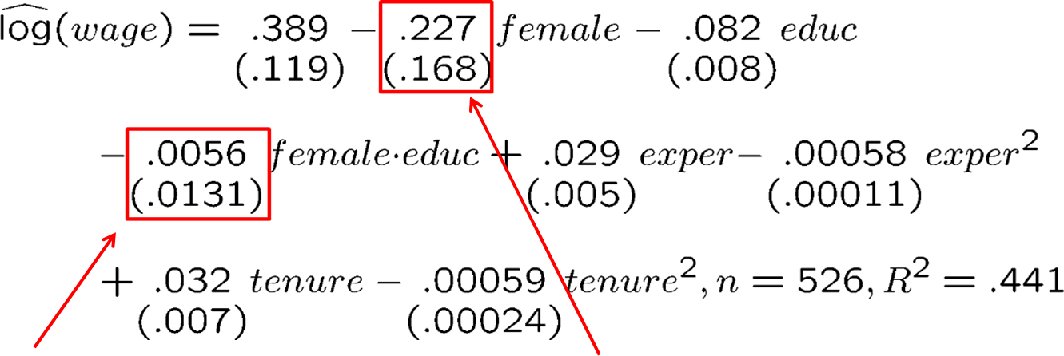
Multiple Regression Analysis with Qualitative Information (12 of 24)
Estimated wage equation with interaction term
No evidence against hypothesis that the return to education is the same for men and women.
Does this mean that there is no significant evidence of lower pay for women at the same levels of educ, exper, and tenure? No: this is only the effect for educ = 0. To answer the question one has to recenter the interaction term, e.g. around educ = 12.5 (= average education).

Slide 14
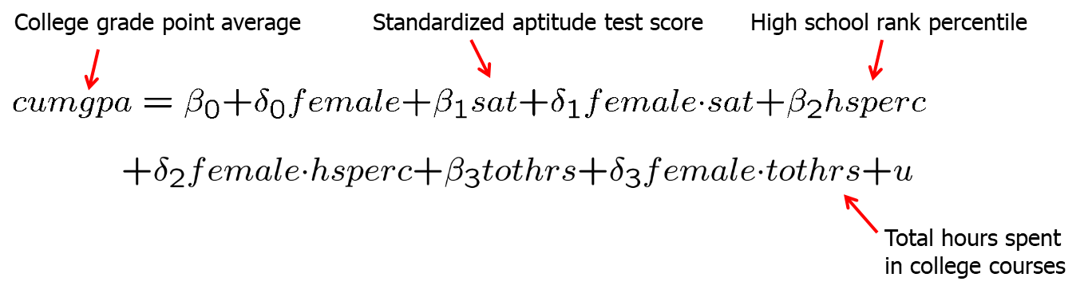
Multiple Regression Analysis with Qualitative Information (13 of 24)
Testing for differences in regression functions across groups
Unrestricted model (contains full set of interactions)
Restricted model (same regression for both groups)

Slide 15
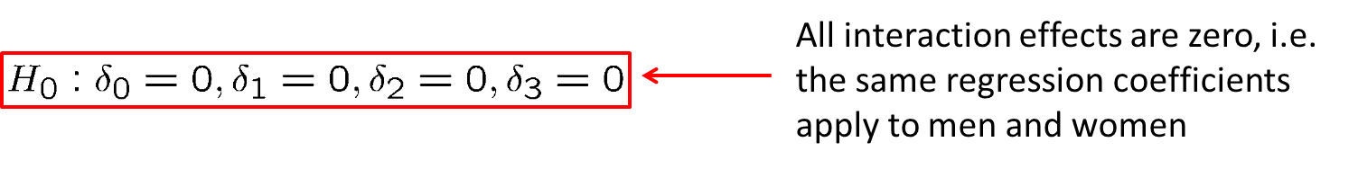
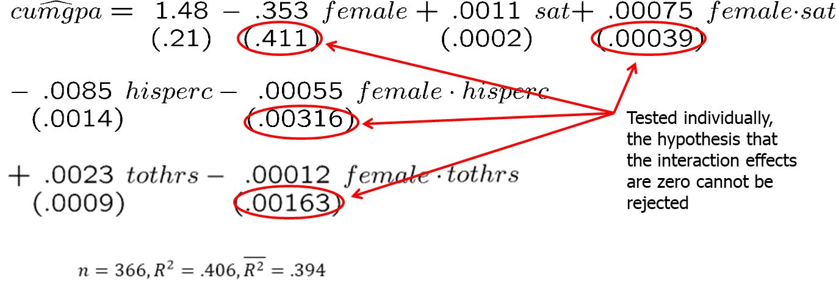
Multiple Regression Analysis with Qualitative Information (14 of 24)
Null hypothesis
Estimation of the unrestricted model

Slide 16
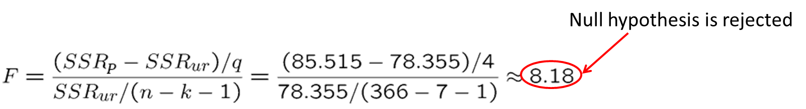
Multiple Regression Analysis with Qualitative Information (15 of 24)
Joint test with F-statistic
Alternative way to compute F-statistic in the given case
Run separate regressions for men and for women; the unrestricted SSR is given by the sum of the SSR of these two regressions.
Run regression for the restricted model and store SSR.
If the test is computed in this way it is called the Chow-Test.
Important: Test assumes a constant error variance across groups.

Slide 17
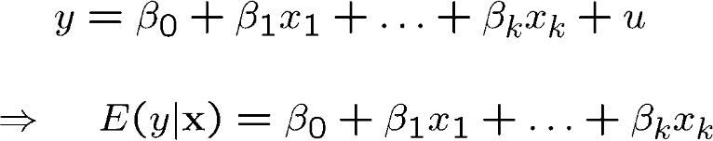
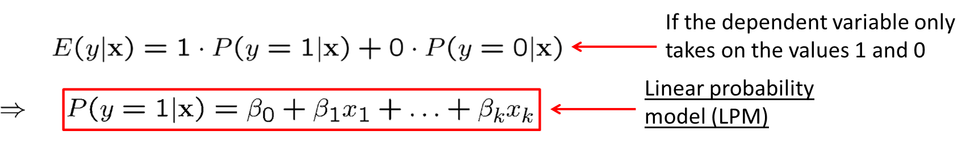
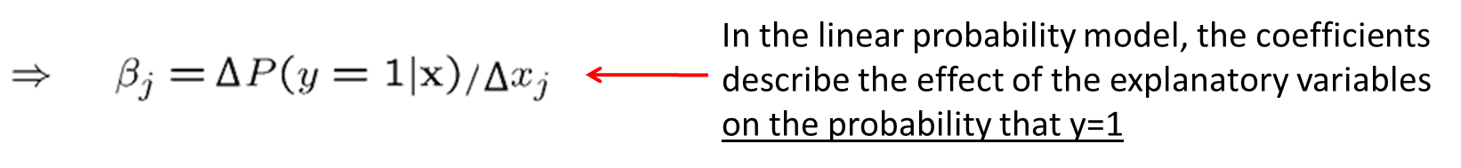
Multiple Regression Analysis with Qualitative Information (16 of 24)
A Binary dependent variable: the linear probability model
Linear regression when the dependent variable is binary

Slide 18
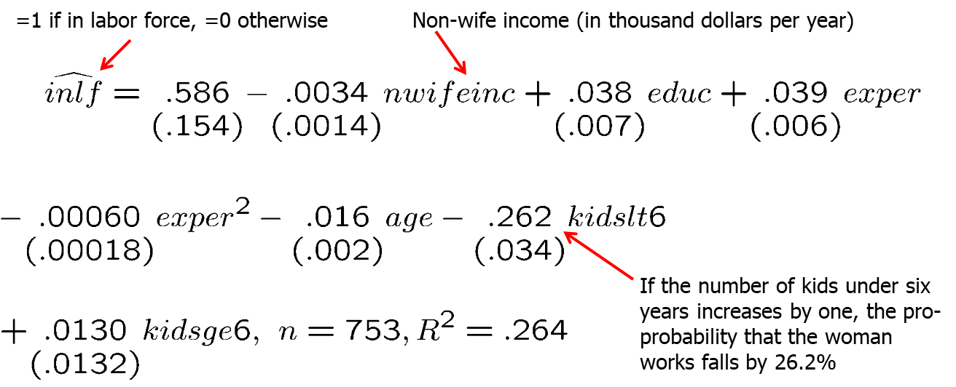
Multiple Regression Analysis with Qualitative Information (17 of 24)
Example: Labor force participation of married women

Slide 19
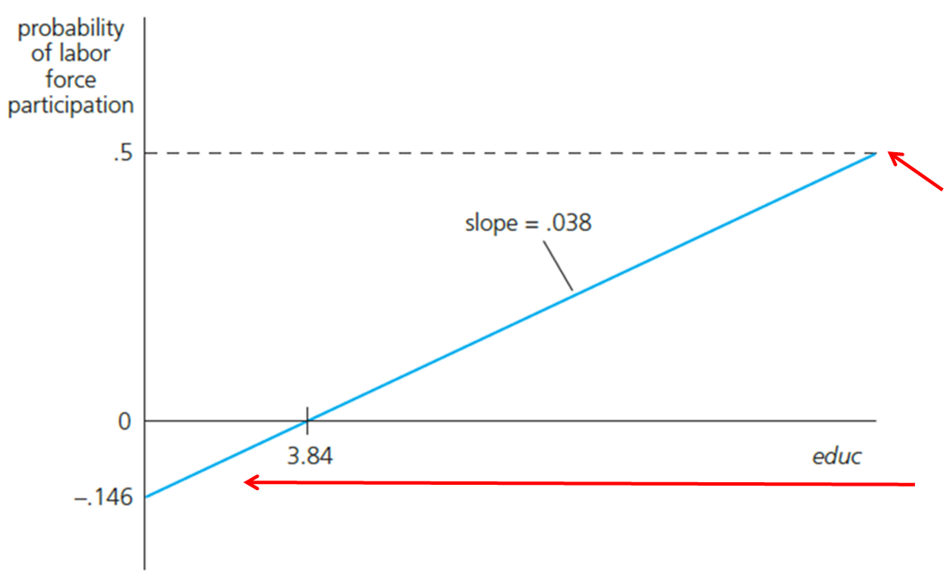
Multiple Regression Analysis with Qualitative Information (18 of 24)
Example: Female labor participation of married women (cont.)
Graph for nwifeinc=50, exper=5, age=30, kindslt6=1, and kidsge6=0
The maximum level of education in the sample is educ=17. For the given case, this leads to a predicted probability to be in the labor force of about 50%.
There is a negative predicted probability, but no problem because no woman in the sample has educ < 5.

Slide 20
Multiple Regression Analysis with Qualitative Information (19 of 24)
Disadvantages of the linear probability model
Predicted probabilities may be larger than one or smaller than zero.
Marginal probability effects sometimes logically impossible.
The linear probability model is necessarily heteroskedastic.
Thus, heteroskedasticity consistent standard errors need to be computed.
Advantages of the linear probability model
Easy estimation and interpretation
Estimated effects and predictions are often reasonably good in practice.

Slide 21
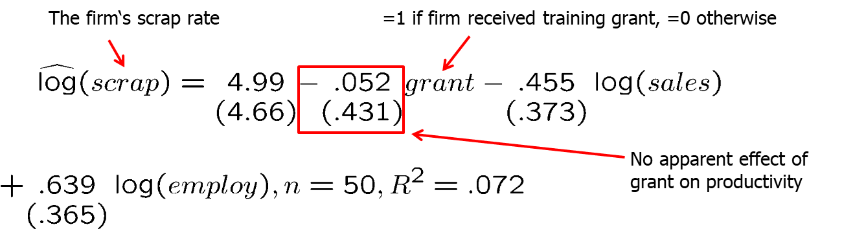
Multiple Regression Analysis with Qualitative Information (20 of 24)
More on policy analysis and program evaluation
Example: Effect of job training grants on worker productivity
Treatment group: grant receivers, Control group: firms that received no grant
Grants were given on a first-come, first-served basis. This is not the same as giving them out randomly. It might be the case that firms with less productive workers saw an opportunity to improve productivity and applied first.

Slide 22
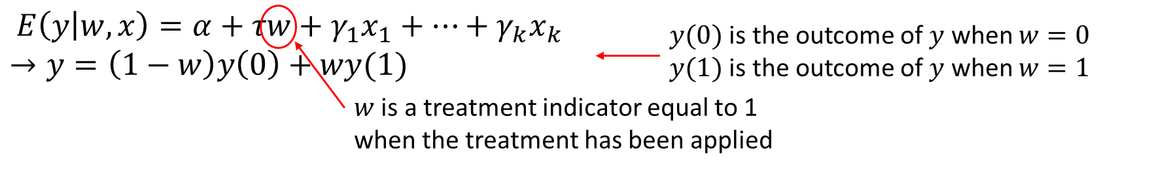
Multiple Regression Analysis with Qualitative Information (21 of 24)
Addressing the problem of self-selection
We include x₁ through x_{j} to account for the possibility that the treatment (w) is not randomly assigned.
For example, children eligible for a program like Head Start participate based on parental decisions. We thus need to control for things like family background and structure to get closer to random assignment into the treatment (participates in Head Start) and control (does not participate) groups.

Slide 23

Multiple Regression Analysis with Qualitative Information (22 of 24)
Addressing the problem of self-selection continued (cont.)
Consider the simple regression:
We need to make the strong assumption that w is independent of [y(0),y(1)]. In other words, treatment is randomly assigned.
A more convincing case is to include covariates x₁ through x_{j}
Now we assume that w is independent of [y(0),y(1)] conditional upon x₁ through x_{j}.
This is known as regression adjustment and allows us to adjust for differences across units in estimating the causal effect of the treatment.

Slide 24
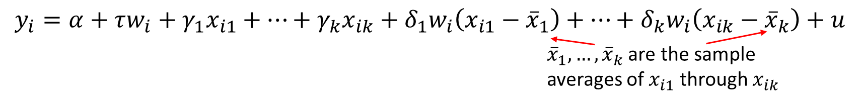
Multiple Regression Analysis with Qualitative Information (23 of 24)
Relaxing the assumption of a constant treatment effect
We can allow the treatment effect to vary across observations and instead estimate the average treatment effect (ATE)
The estimated coefficient on w will be the ATE.
The regression that allows individual treatment effects to vary is known as the unrestricted regression adjustment (URA).
By contrast, a restricted regression adjustment (RRA) forces the treatment effect to be identical across individuals.

Slide 25
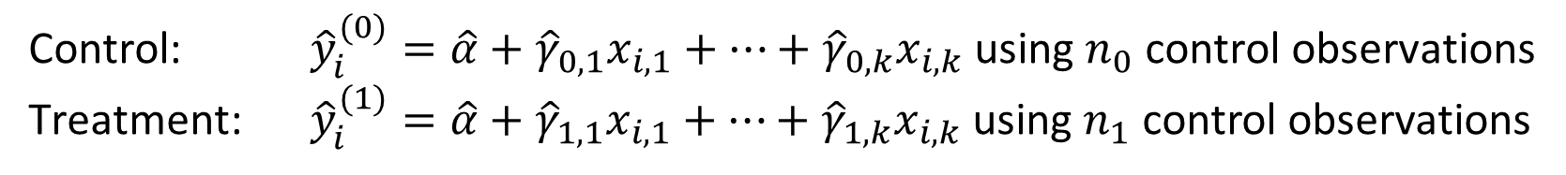
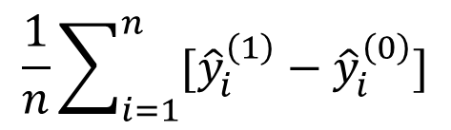
Multiple Regression Analysis with Qualitative Information (24 of 24)
An alternative method for obtaining the URA ATE
Now for every unit in the sample, predict y_{i}(0) and y_{i}(1) regardless of whether the unit is in the control or treatment groups.
Use these predicted values to compute the ATE as:
Though this yields the same ATE as running the regression with interaction terms, computing a standard error by hand can be tricky.

